Slide 1
S.T.A.R. TEAM 6
PRESENTATION

Slide 2
TEAM MENTORS
BHUVAN AGGARWAL
HANAN BASHEER
MANAV DOSHI
TEAM
SARVADNYA DESAI
CIVIL DEPARTMENT
210040138
SAHIL SUDHAKAR
AEROSPACE DEPARTMENT
210010055
ATHARV. HARDIKAR
MECHANICAL DEPARTMENT
210100034
4. HEMANT MEENA
MECHANICAL DEPARTMENT
210100070

Slide 3
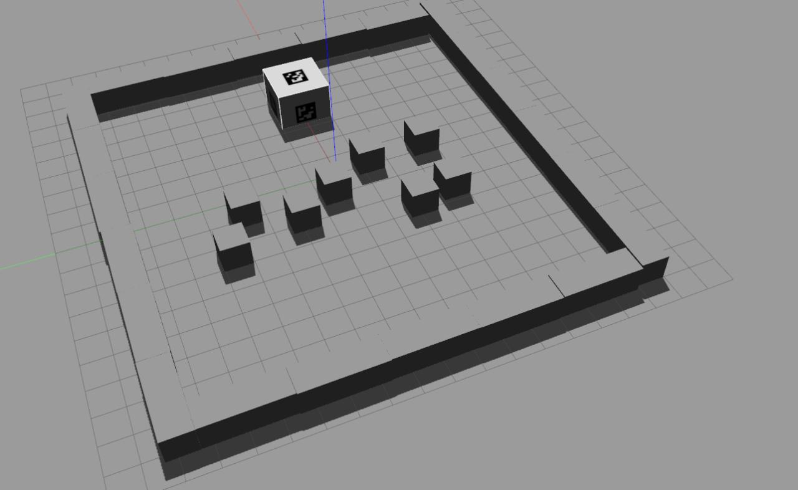
WHAT WE UNDERSTOOD FROM THE PROBLEM STATEMENT
The unguided ground vehicle (UGV) that we are supposed to create will occupy 42cm*42cm*42cm volume initially, while functioning it can change size.
Colour signs have to be used.
The valley is of square shape and of 12m*12m size with an Aruco marker fitted somewhere in between and blocks as the obstacles.
We’ve to take the inventory items of Cuboidal, Cylindrical or Thin Plate shape and precisely drop it to the place without losing connection at any instant.
Our bot is equipped with all kind of sensors that are required.
A glance to how our world will look like

Slide 4
The four pillars of our work
ROS or Robot operating system provided us the software frameworks for robot software development.
It provides services designed for package management, message passing between processes. It provides facility of nodes, Nodes are combined together into a graph and communicate with one another using streaming topics, RPC services, and the Parameter Server.
Solidworks provided the software for precisely constructing the bot. Right from it’s wheels to the top end and the hand to pick the box, everything is designed on solid works only.
OpenCV is a python library that helped us in detecting the Arucomarker. It is helpful in obstacle detection with the help of depth camera and other things.
Gazebo provided the much needed environment for launching the bot and visually see if all the files are running how they were supposed to be as per the URDF file.

Slide 5
FLOW OF CONTROL INTERPRETATION
/topic1
/initial pose
Follow_way
Points
Waypoints
X
T
U
(geometry_msg
(Pose with covariance
stumped)
(Geometry_msgs/
Pose Array)
Path_reading
(std_msgs)
move_base_
Simple/goals
(geometry_msgs
Pose Stumped)
Odom
diff_drive_
Controller
Cmd_vel/
move_base
(Node)
V
now_msgs/
Odometer
(geometry_
Msgs/Twist)
/Topic2
(Custom_msg)
(Motors of the robot)

Slide 6
SIMULATION
The robot file is launched and the robot appears in the GAZEBO, then the depth camera was added to the robot which provides the exact location of the Aruco and then detect the distance between the Aruco marker and the robot.
The robot will then move according the provided coordinates.
The robot designed on the solidworks consist of the four wheels guided by four individual motors without any axle.
The waypoints provided are then passed on to the Node called FOLLOW_WAYPOINTS then the data is further published to another Node called MOVE_BASE.
Then the Inter Coalition Function I.e. the smooth function along the waypoints provided which gives velocity and angular velocity along all three directions comes into effect.
Feedback of the difference between the actual path and the ideal path is calculated in every step and accordingly the difference will be minimized with each step.
Using the differential drive, now the odometry data is received.
Then the spawning is done and the word file is converted to URDF file and the ROBOT in GAZEBO world is formed.
This is how the simulation takes place.

Slide 7
THE PICTORIAL REPRESENTATION OF SIMULATION
THE DESIGNED ROBOT
THE WORLD IN GAZEBO

Slide 8
ROBOT IN THE WORLD
ROBOT DETECTING THE ARUCO MARKER
ARUCO MARKER DETECTED

Slide 9
EXPERIENCE AND TROUBLES WHILE SOLVING PS
CONTROLS
Controls - primary experience - ROS
Challenge in visualization of physical parameters in simulation.
A lot of online surfing for existing ROS nodes and connecting them together.
Debugging - welcome to everybody's nightmare.
The overall experience of working in control division.
Issues faced by control:
Unable to publish a continuous stream of msgs to /waypoint topic.
Unable to effectively use the path_ready topic for follow_waypoints node.
Conversion of a 2 wheel drive to a 4 wheel drive control without adequate exposure to control mathematics.

Slide 11
DESIGN
The design of the robot is made on the solid works software.
Some inspiration from google led to formation of Rocker Bogie.
Due to change in PS the design has to be changed to a four wheeled vehicle mounted with electronic systems.

Slide 12
THANK YOU! :)

